Slide 1


Tic Tac Toe Threaded in C
Authored by:
Zak Groenewold, Samuel Arne, Dinesh Seveti

Slide 2
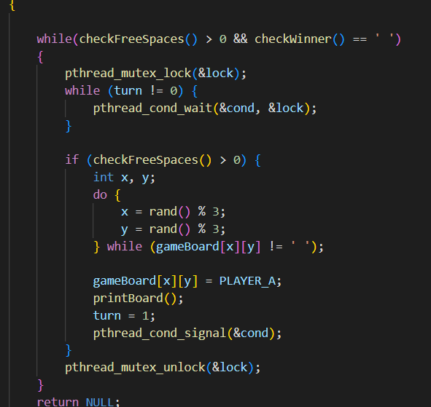
Player Move Functions
The player move functions utilized the pthread package to access mutex locks and unlocks. This made sure that only one player at a time could make a choice.

Slide 3
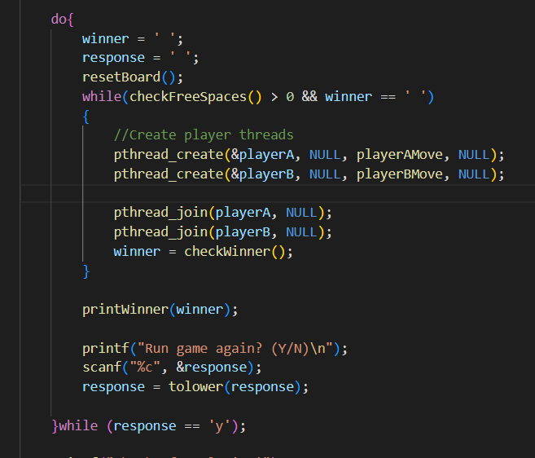
Main Game Loop
The main game loop shows how a thread is created for each player, and how the threads are joined so that they don’t interrupt each other.

Slide 4
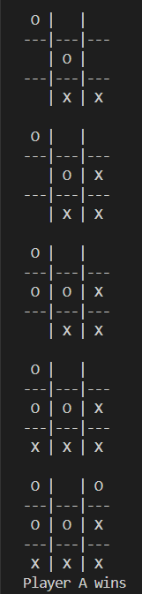
Results
This screenshot shows the game in action. Each player takes a turn, and the board is printed each time. Player A represented by ‘X’ wins this game, and the result is printed.

Slide 5

Thank you for your time!

